Slide 1

Didactic game: «The Great Patriotic War:
Heroes and Battles»
Authors:
Zaripova Alsu Rifatovna, English teacher,
MBGEI "Technological Lyceum "Algorithm";
Pirvanaeva Ira Amrullaena, English teacher,
MBGEI "Technological Lyceum "Algorithm“.

Slide 2
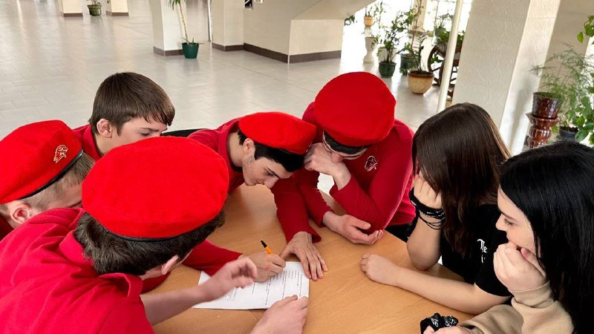
Rules
Teams
Questions
The class is divided into 3 teams:
Liberators, Defenders, Heroes.
Each team receives 10 questions in English.
Difficulty levels
Victory
Questions vary in complexity: facts, personalities, analysis of events.
The team with the highest number of points wins.

Slide 3
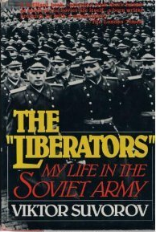
Team 1: Liberators
1. What was the code name for Nazi Germany’s invasion of the USSR?
2. Which Soviet city survived a 872-day siege?
3. Who was the Soviet leader during WWII?
4. What was the largest tank battle of WWII?
5. Which Soviet sniper killed over 300 enemy soldiers?
6. What is the name of the Soviet rocket launcher used in WWII?
7. Which river did Soviet soldiers cross during the Battle of Stalingrad?
8. In which year did the Battle of Berlin take place?
9. What does "Blitzkrieg" mean?
10. Which medal was awarded to the defenders of Moscow?

Slide 4
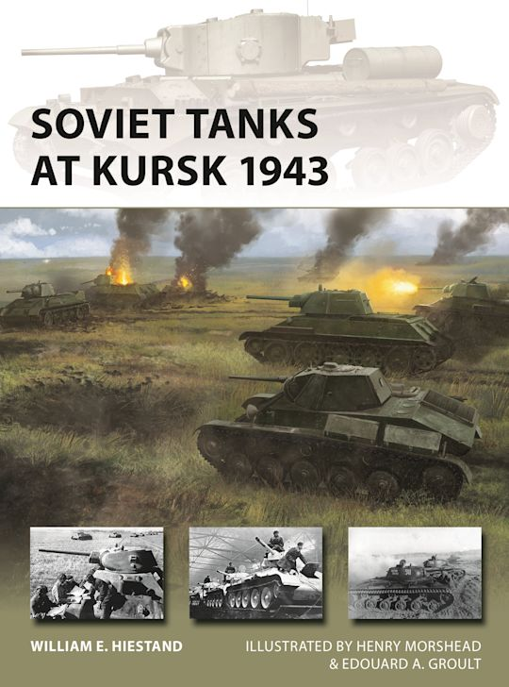
Team 2: Defenders
Which Soviet operation led to the liberation of Belarus in 1944?
Who was the commander of the Soviet forces at Stalingrad?
What was the nickname of the Soviet fighter plane "IL-2"?
Which country was the first to be liberated by the Red Army?
Name the Soviet pilot who continued flying after losing both legs.
What was the main goal of Operation Typhoon?
Which Soviet city was renamed Volgograd after the war?
Who signed the German surrender on behalf of the USSR?
What was the "Road of Life"?
Which Nazi leader committed suicide in 1945?

Slide 5
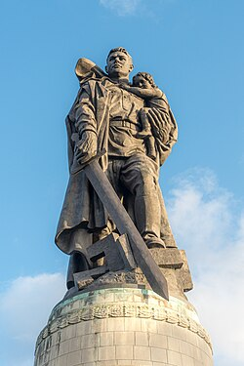
Team 3: Heroes
Which battle marked the turning point on the Eastern Front?
Who was the first woman to become a Hero of the Soviet Union?
What does "Gulag" stand for?
Which Soviet marshal captured Berlin?
What was the "Night Witches" nickname given to?
Which concentration camp was liberated by the Red Army?
How many Soviet civilians died during WWII?
What was the name of the Soviet partisan leader?
Which Soviet republic lost 25% of its population in the war?
What phrase ended Soviet radio broadcasts during the war?

Slide 6
Keys
Liberators Operation Barbarossa Leningrad Joseph Stalin Battle of Kursk Vasily Zaytsev Katyusha Volga 1945 Lightning war For the Defence of Moscow | Defenders Operation Bagration Vasily Chuikov Flying Tank Poland (1944) Alexey Maresyev Capture Moscow Stalingrad Georgy Zhukov Supply route to Leningrad Adolf Hitler | Heroes Stalingrad Zoya Kosmodemyanskaya Main Camp Administration Ivan Konev Female Soviet bomber pilots Auschwitz Approx. 17 million Sidor Kovpak Belarus "Our cause is just, victory will be ours!"

Slide 7
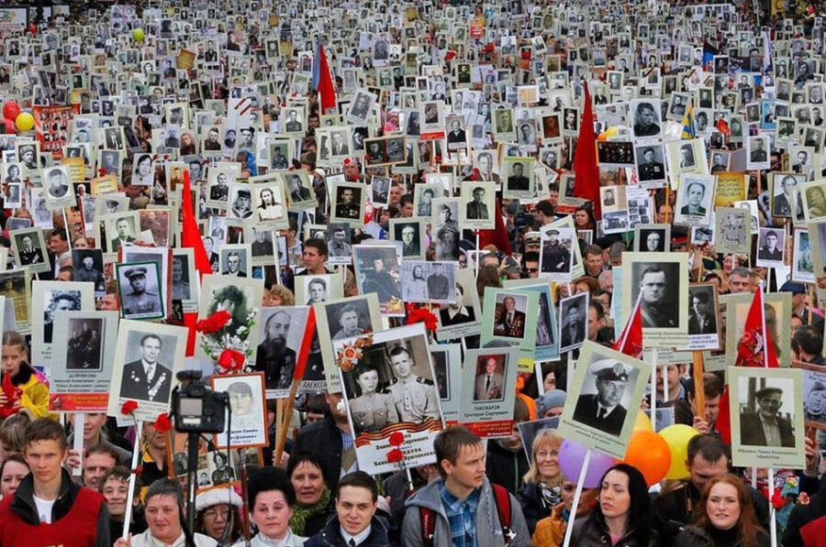
Creative Assignment: "Letters Through Time"
Objective:
Imagine you are a time traveler who has the ability to send letters between the past and the present. Your task is to write a heartfelt letter from the perspective of someone living during World War II (a soldier, a nurse, a child, or a civilian) to a person living in the modern day. Then, write a response from the modern-day person back to the WWII individual.
Instructions:
Choose Your Perspective:
  Decide who you are writing as during WWII (e.g., a soldier on the front lines, a mother waiting for her son to return, a child in a bomb shelter, or a resistance fighter).
  Decide who you are writing to in the modern day (e.g., a student, a historian, a grandchild, or even yourself).
Write the WWII Letter:
  Describe your daily life, fears, hopes, and dreams during the war.
  Share your thoughts on the world, the future, and what you wish people in the future would remember about this time.
  Ask questions about the future (e.g., "Has the world learned from this war?" or "What is life like in your time?").

Slide 8
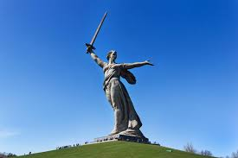
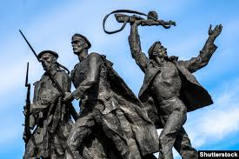
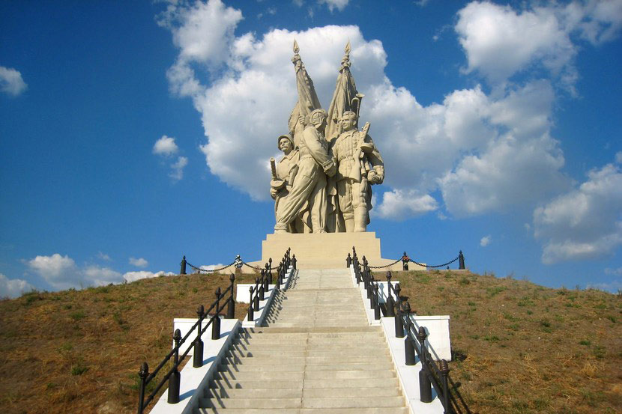
Creative task (additional points)
Task: Create a short patriotic slogan in English to honor WWII heroes. Use words like "courage," "memory," or "peace."
Example: "Courage of the past lights the path to peace!"

Slide 9

Reflection
1
2
3
Amazing fact
Memorable word
Favourite task

